Slide 1
Squishy Faces
Information sheets
Spiel about inbred animals
Spiel about adopt don’t shop
Comment Board
Speciality rescues
Login / Logout / profile
Donate to Squishies Flat-Faced Rescue
DONATE

Slide 2
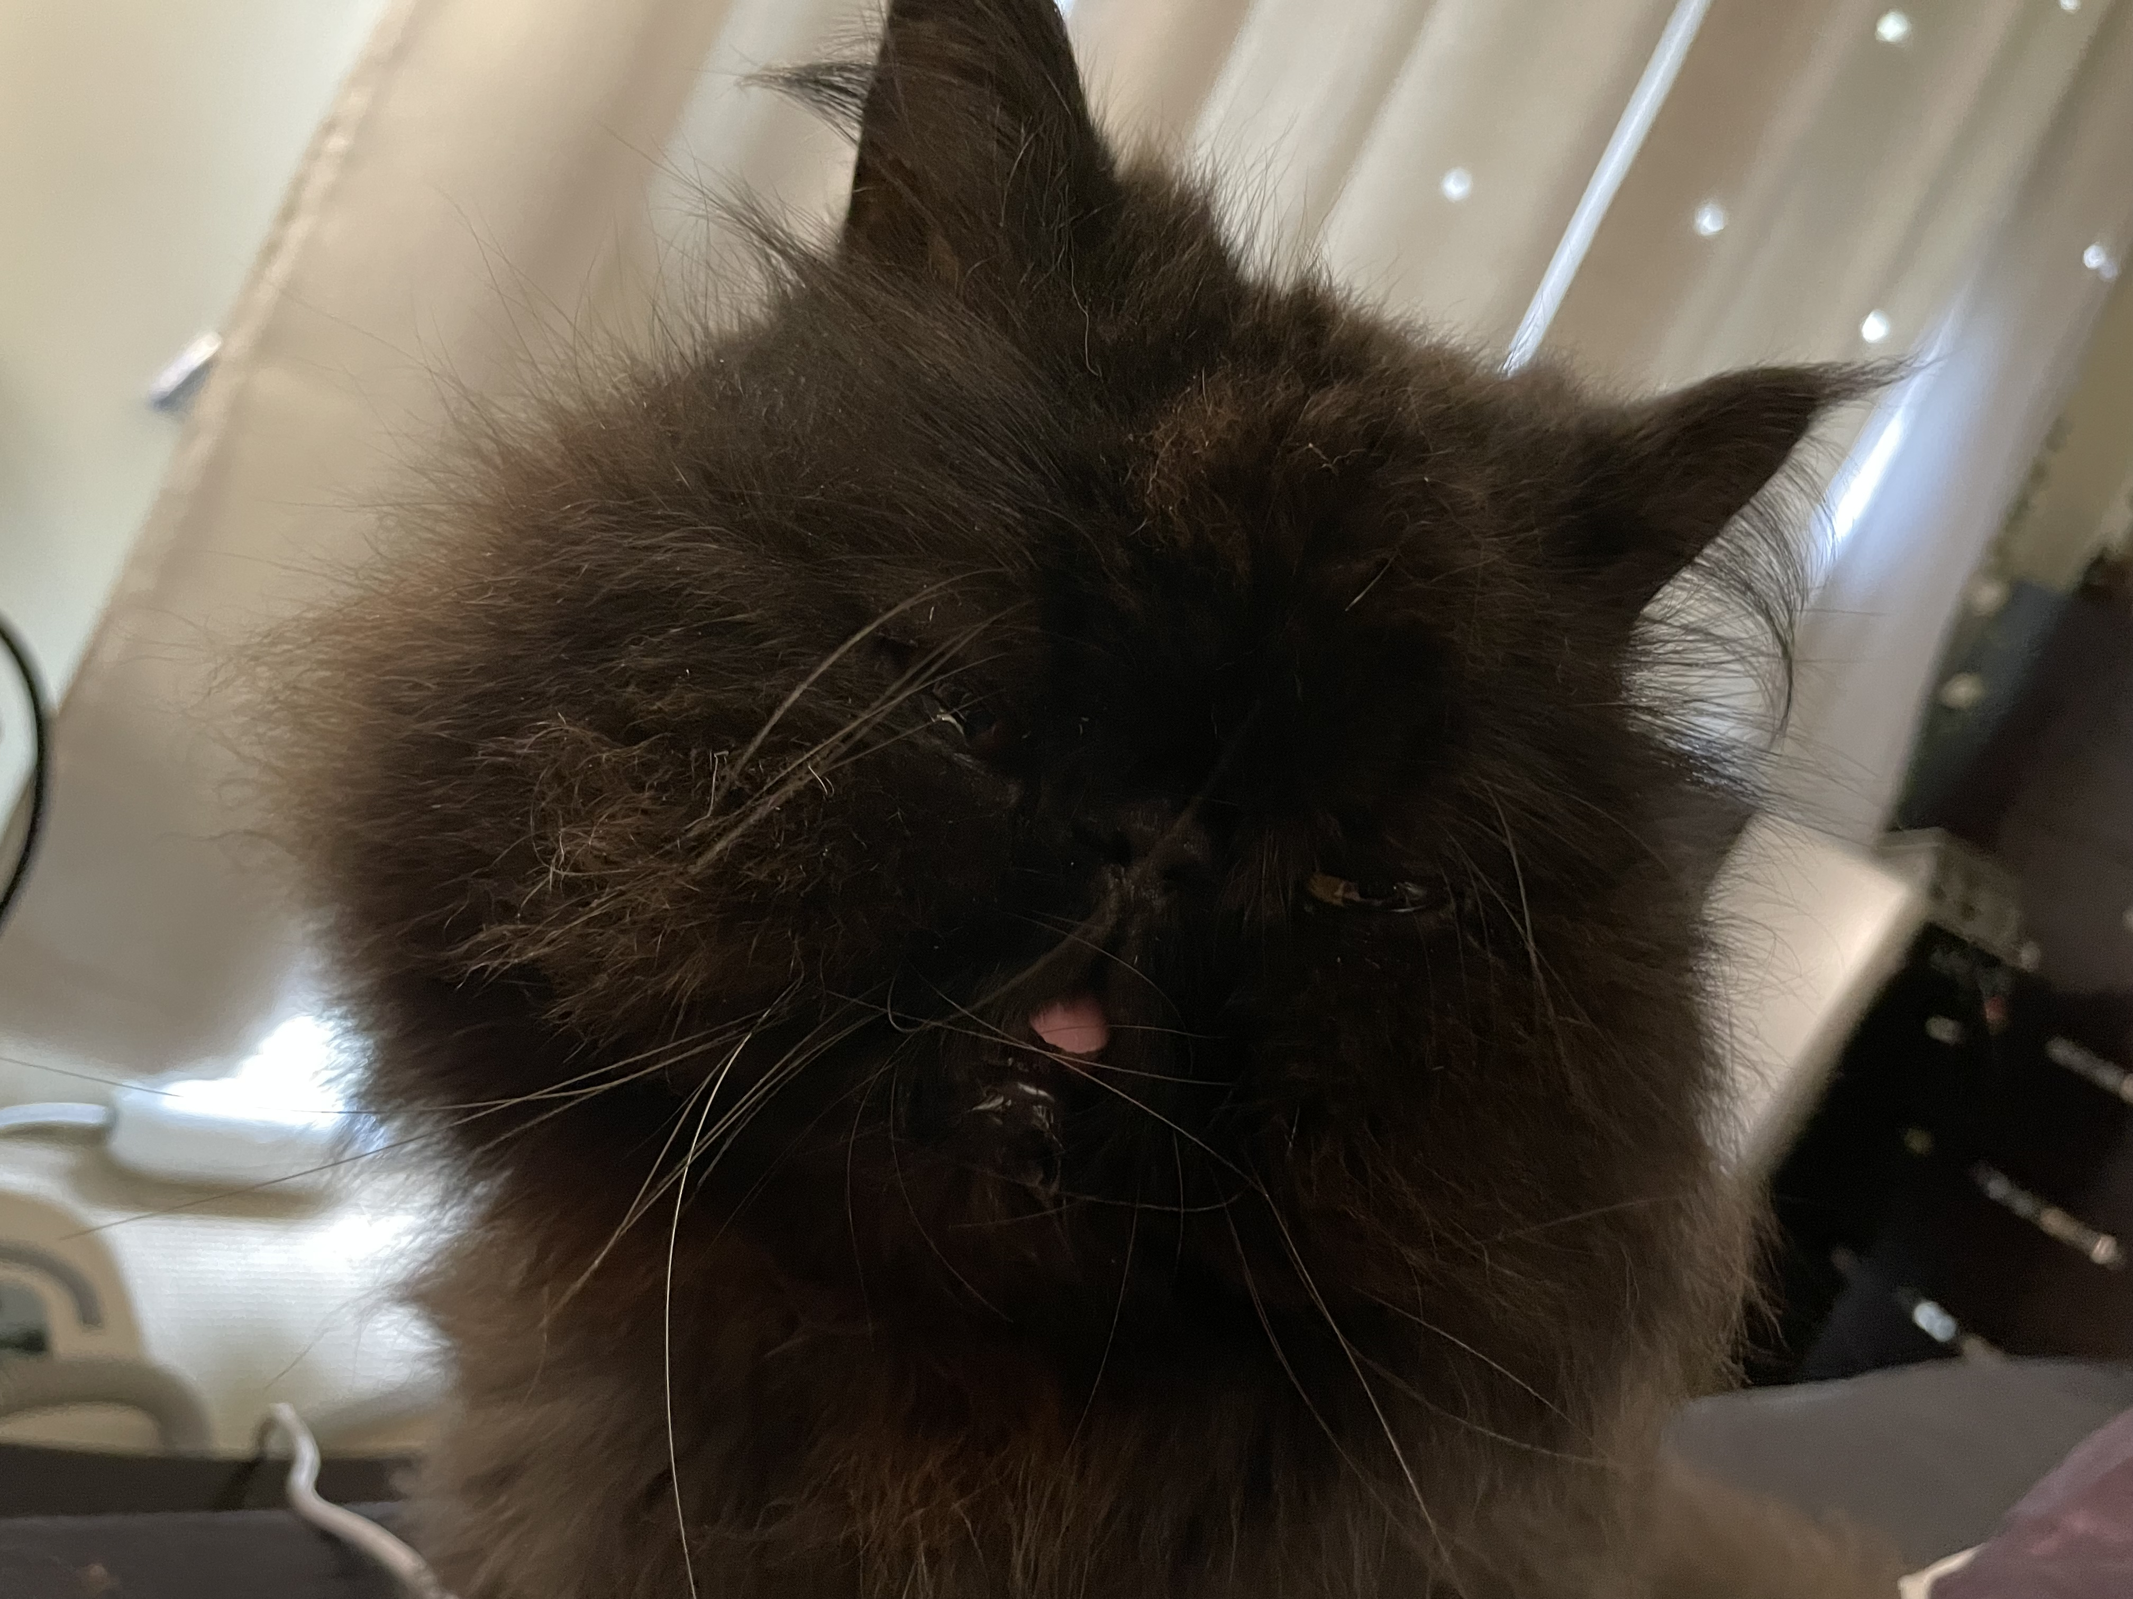
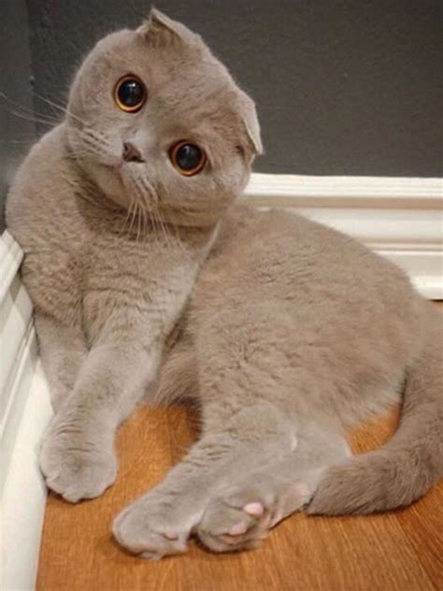
Breed Information
Comment Board
Brachycephalic animals
Speciality rescues
Fold breeds
Login / Logout/profile
Donate to Squishies Flat-Faced Rescue
DONATE

Slide 3
Brachycephalic Animals
Information sheets
Comment Board
Spiel here about bracys
Speciality rescues
Login / Logout/profile
Donate to Squishies Flat-Faced Rescue
DONATE

Slide 4
Brachycephalic Animals
Information sheets
Comment Board
Spiel here about folds
Speciality rescues
Login / Logout/profile
Donate to Squishies Flat-Faced Rescue
DONATE

Slide 5
Comment Board
User1 at 12/11/10 09:08
This site rocks
Information sheets
Speciality rescues
User2 at 13/11/10 09:08
I agree that this site rocks
Login / Logout / profile
Donate to Squishies Flat-Faced Rescue
DONATE

Slide 6
Speciality Rescues
Select state
Squishies Flat-Face Rescue
Suburb, State
Website
FB/IG/Twitter
Information sheets
Another Specialty Rescue
Suburb, State
Website
FB/IG/Twitter
Speciality rescues
Login / Logout / profile
Donate to Squishies Flat-Faced Rescue
DONATE

Slide 7
Profile
Information sheets
Welcome, Username
Add a rescue profile
Existing rescue profile
Add Name
Add suburb
Add state
Add website
Add FB / IG / Twitter
Comment Board
Add Name
Add suburb
Add state
Add website
Add FB / IG / Twitter
Speciality rescues
Logout
Donate to Squishies Flat-Faced Rescue
DONATE
Edit / Delete

